Slide 1
Scientific Calculator Using Python
Project Name: Scientific Calculator Using Python
Presented by: Mobassher Khandakar This presentation introduces my project, which is a scientific calculator developed using Python and Kivy. The project aims to deliver a versatile and user-friendly tool that encompasses basic and advanced mathematical functionalities.

Slide 2
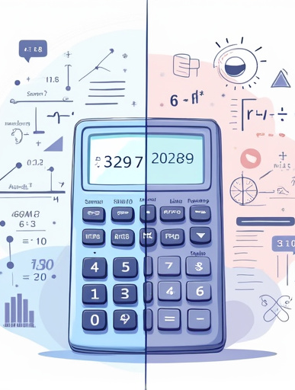
Introduction
Overview of the Project: The scientific calculator is an simple tool designed to perform a variety of calculations seamlessly. It integrates basic operations with scientific functionalities, making it suitable for a wide range of users.
Flexibility: The calculator adapts to user needs with various features.
User-Friendly Interface: A simple yet effective GUI that enhances user experience.
Comprehensive Functionality: From basic math to scientific calculations, this calculator aims to cover all essential features.

Slide 3
Technologies Used
Core Technologies
Additional Libraries
- Python: The primary programming language that powers the calculator's logic and functionality.
- Kivy: A powerful GUI framework that enables the creation of multi-touch applications, providing a modern interface for the calculator.
- Math Library: Utilized for executing advanced mathematical functions.
- Datetime Library: Implements the age calculator feature, allowing users to calculate age based on their birth date.
- Random Library: Generates random values for various applications within the calculator.

Slide 4
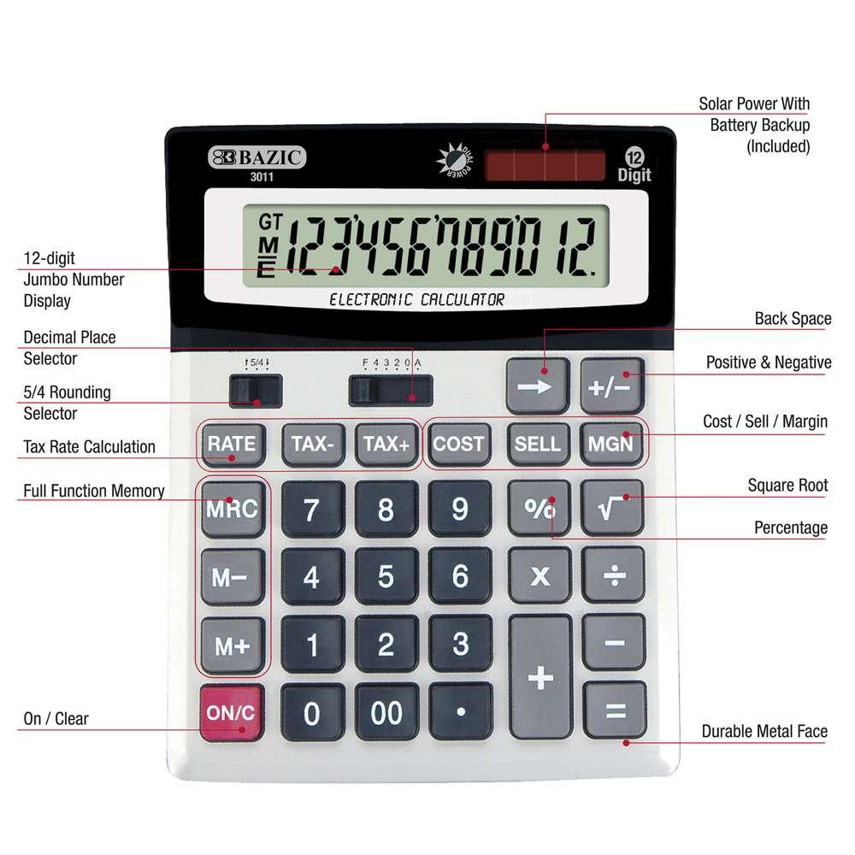
Features Overview
Basic Operations:
Addition: Perform simple arithmetic addition.
Subtraction: Subtract one number from another.
Multiplication: Multiply two numbers.
Division: Divide one number by another.
Trigonometric Functions: Calculate sine, cosine, and tangent values.
Logarithms: Compute natural and base-10 logarithms.
Factorial: Calculate the factorial of a number.
Square Root: Find the square root of a number.
Exponentiation: Raise a number to the power of another.
Store: Save a value in memory for later use.
Recall: Retrieve the stored value.
Clear Memory: Remove any stored values from memory.
Age Calculator: Determine a person's age based on their birthdate.
Currency Converter: Convert between different currencies.
Temperature Converter: Change temperature values between Celsius and Fahrenheit.
Dark Mode: A visually appealing dark theme for comfortable usage in low light.
Scientific Mode Toggle: Switch between basic and scientific calculator layouts with ease.

Slide 5
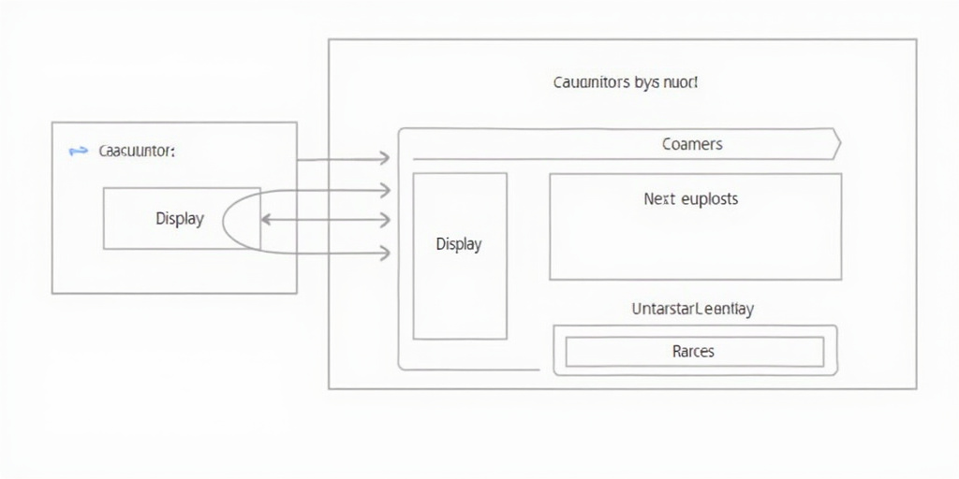
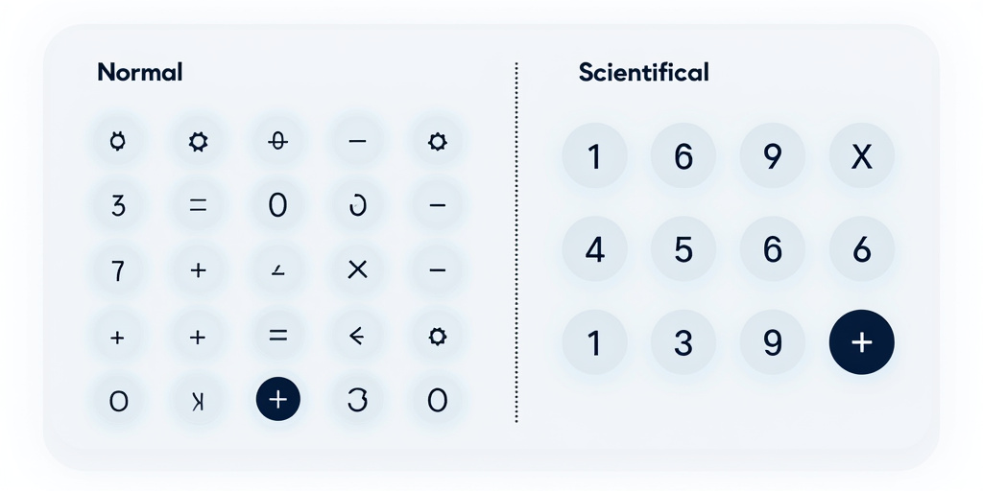
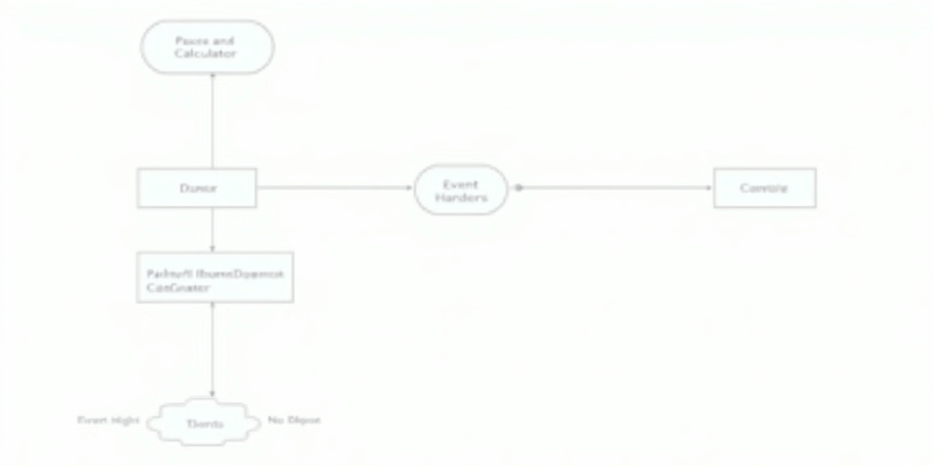
Code Structure
CalculatorScreen Class
Button Layouts
Event Handlers
Functionality: Manages the user interface and calculator logic, acting as the main controller for the app.
Organization: Buttons are categorized into normal and scientific groups for intuitive access.
Responsiveness: Handles button clicks, mode toggles, and performs calculations based on user input.

Slide 6

Conclusion
Project Highlights: This scientific calculator exemplifies the capabilities of Python and Kivy in creating a versatile application. It merges various mathematical functionalities into a single, cohesive tool.
Enhanced Features: Plans to include graphing capabilities and more advanced mathematical tools.
User Feedback: Incorporating user suggestions to improve functionality and user experience.

Slide 7
Thank You!
Purbadhala,Netrokona
+8801937007185
mobassherkhandakar@gmail.com
https://mobassherkhandakar.netlify.app/

